Slide 1

Analysis on heathcare system
Nikita Nannaware

Slide 2
Datasets:
1.census_data 2011
2. AYUSHHospitals
3. Hospitals
4. Metadata
5. government_hospitals

Slide 3
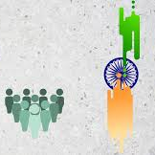
Introduction
A census is a study of every unit, everyone or everything, in a population. It is known as a complete enumeration, which means a complete count..​

Slide 4

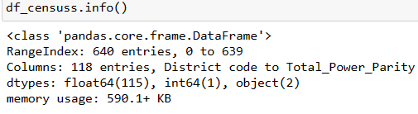
1.Insights about the data
1.The census data has 640 Rows with 118 columns, which includes Population, District names, States etc..
2.Got the information about complete Dataset

Slide 5
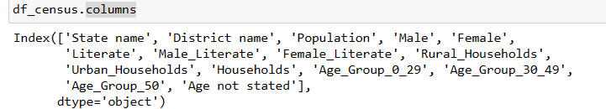
2.Keeping the relevant data
1.The Census 2011 File Contains Many Fields, Which Is Not Needed. So Created New Dataframe With Relevant Data And Columns.

Slide 6
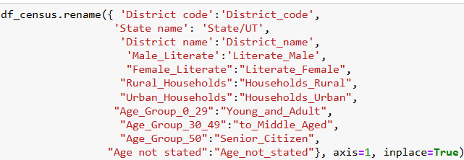
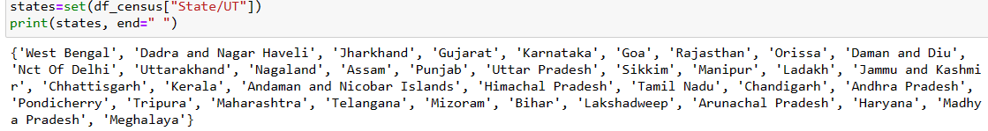
3.Renamed the columns and state names
1.For uniformity in the datasets renamed the some columns.
2.The State/UT names are in all caps in the census data, For uniformity across datasets Renamed the States name in well manner.

Slide 7
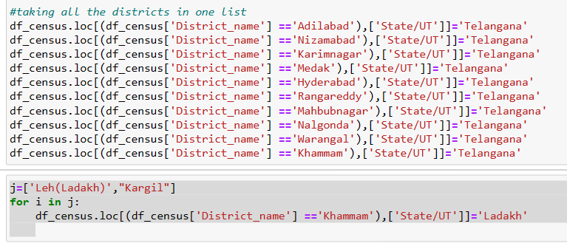
4: (New State/UT formation)
Renamed the State/UT From “Andhra Pradesh” to “Telangana” for the given districts. So for this Reading Telangana.txt file
by using .loc( ) function updating the state name as telangana where the mentioned districts are there
as same as updating the state name for ladakh for the districts leh and kargil

Slide 8
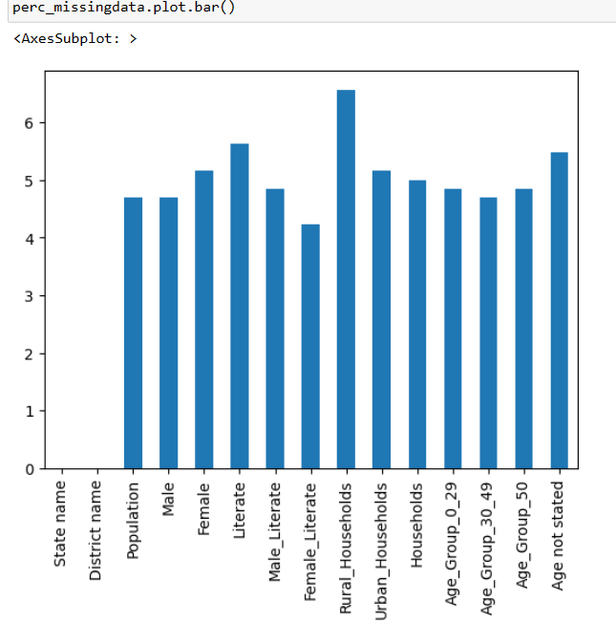
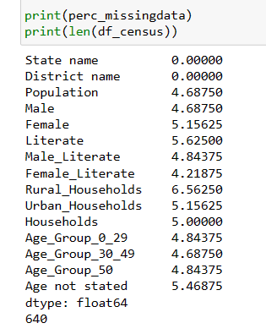
5.Checking for missing values
Here we can see the percentage of missing values in columns.
rural_households, literate, female some of the columns contains higher percentage of missing values

Slide 9
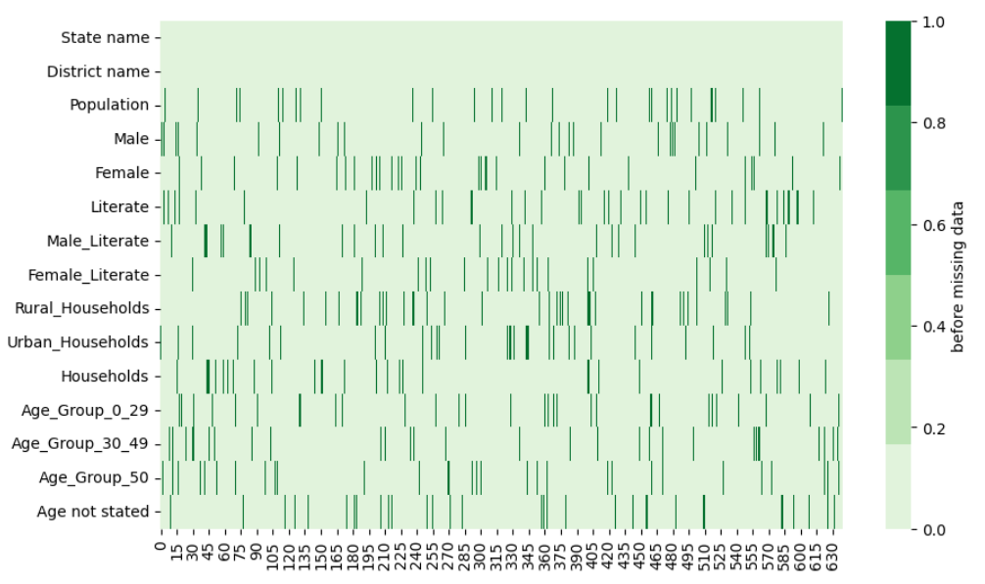
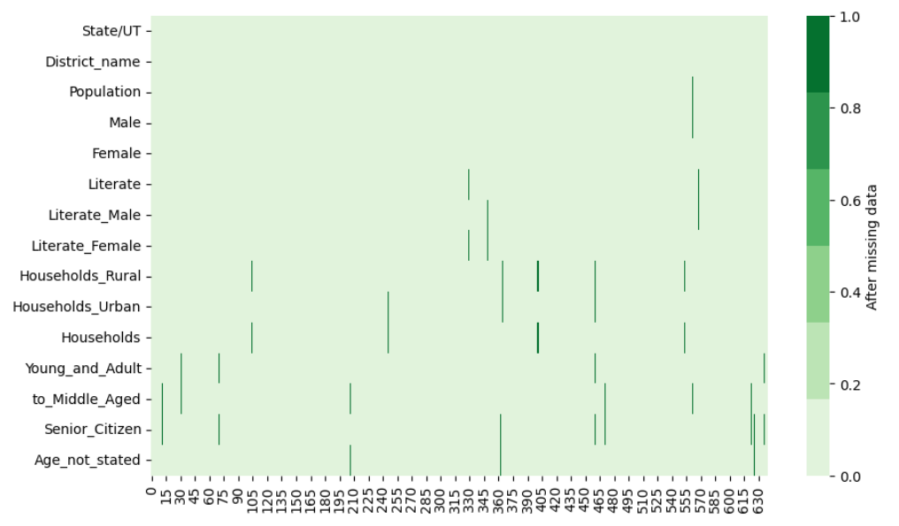
visualization For the missing data before and after the data-filling process
Before Missing values
After Data_filling Process

Slide 10
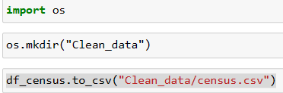
6.Save Data
Saved the processed data to a CSV file named “census.csv” in the “Clean_Data” folder.

Slide 11
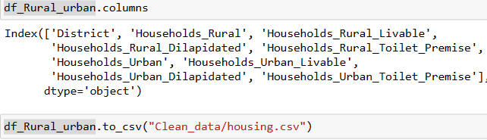
7: Process the relevant data
Found the Absolute Values for the Total Number of Dilapitated, and Latrine_premise for the both rural and urban areas of each districts
Calculated the data and renamed the column names and saved it in a CSV file named “housing.csv” in the “Clean_Data” folder

Slide 12
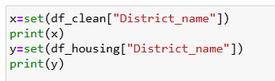

Observation
Question: Report if any district data is in one file but not the other?
Ans: After processing data found that there is no such data which is present in one file but not other

Slide 13
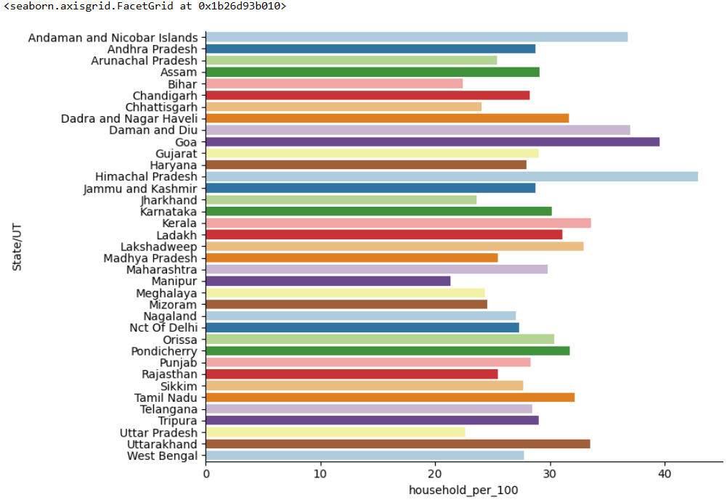

8: Visualise the housing data
Visualized the data for each state using appropriate methods:
Number of households for 100 people

Slide 14
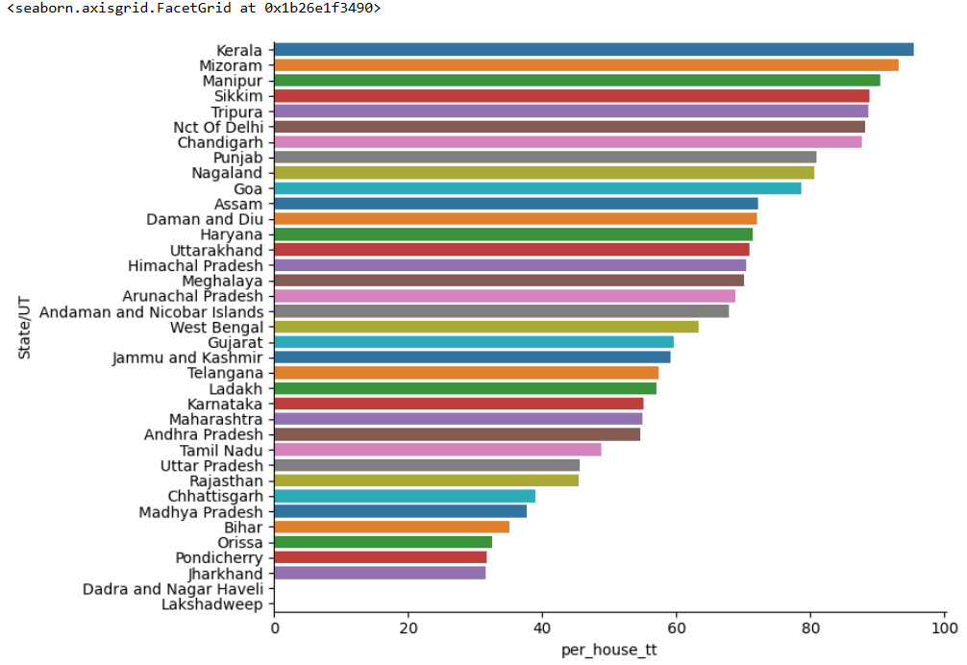
Percentage of households that have toilet(s) in premise to the total number of households.

Slide 15
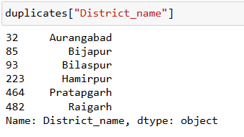
9: Inconsistency in different datasets
Compared the two data and calculated if there is a major difference between the values in the two files.
names of the districts where a major difference is found in the data is as follows:

Slide 16
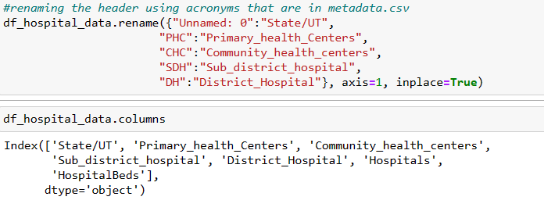
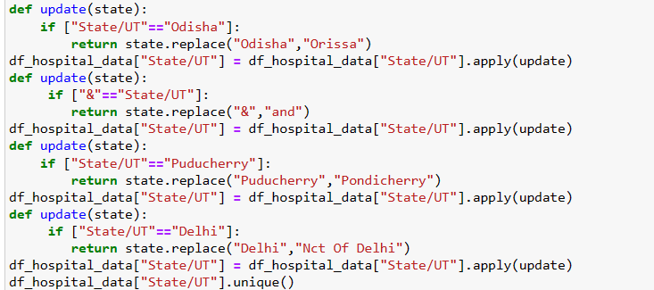
10.Fix the header
11: Create a function to alter the data to create uniformity
The State/UT names had some different formats compared to other census and housing data fixed them using a function.

Slide 17
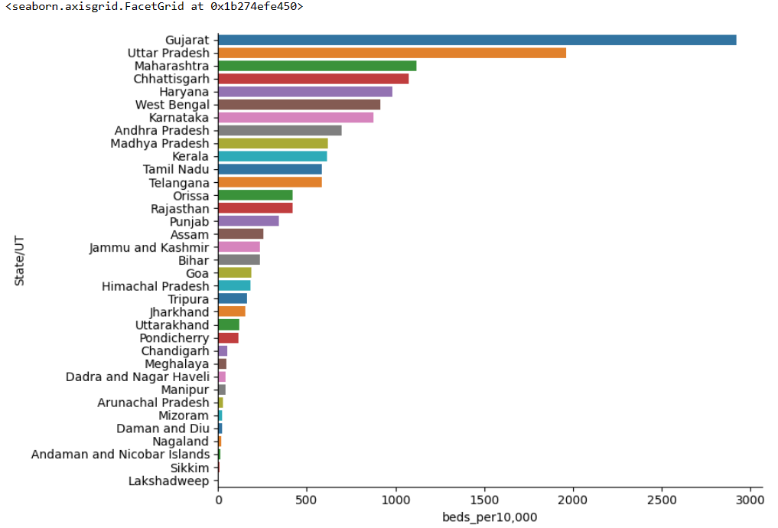
12: Analyze Healthcare facility disparity
Lakshadweep, Sikkim, Andaman and Nicobar Island are the three States/UTs which have the least amount of beds for their population so that more beds can be added to the hospitals in respective states.

Slide 18
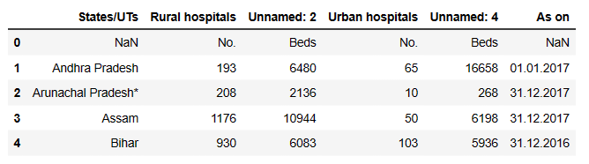
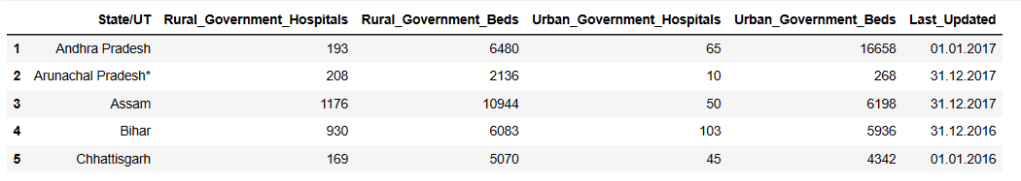
13: Multi-line header
The headers are required to be edited for ease of future use as well as for the sake of uniformity.
So fixed the header by renaming some columns

Slide 19

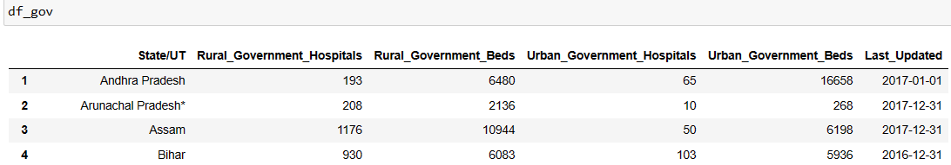
14: Data update and code reuse
The ”Last_Updated” column contained a date that is in the format DD.MM.YYYY but in the future, the date is required in a different format (YYYY-MM-DD) So updated the date to the required format.
The State/UT names had some different formats compared to other census and housing data. Fixed those issues using the function created earlier.

Slide 20
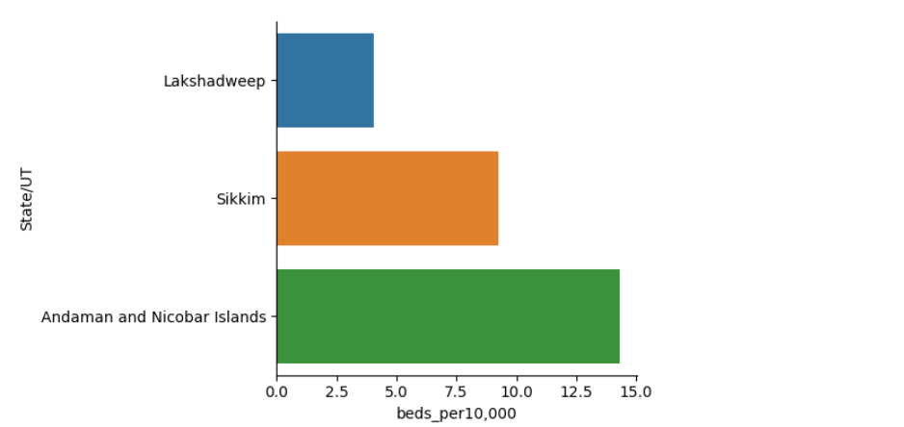
15: Government healthcare facility disparity
Sikkim, Andaman and Nicobar Islands, Lakshadweep have the least amount of beds for their population so that more beds can be added to the hospitals

Slide 21
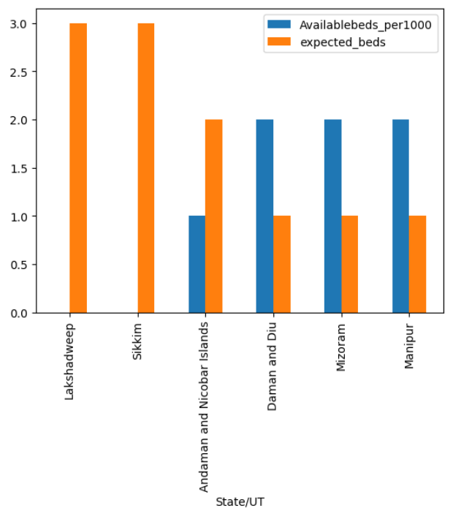
16: Gap in number of beds
Difference between the expected number of hospital beds and the available number of hospital beds in each State/UT.
States that are not missing WHO standards:Lakshdweep, sikkim, nagaland, andaman and nicobar island, Daman diu, Mizoram.

